Slide 1


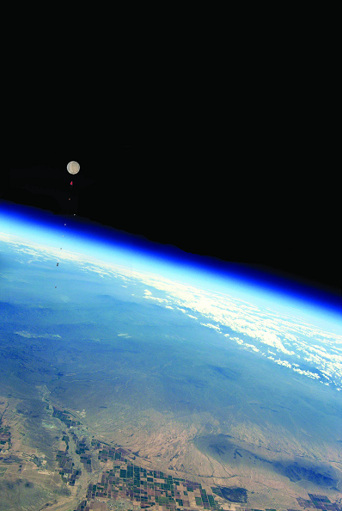
By: Ruben Gameros
Mentor: Dr. Thomas Sharp
By : Ruben Gameros
Mentor: Dr. Tom Sharp

Slide 2
ASCEND: Payload structure design
Overview
This year ASU ASCEND launched two different payloads
Under the conditions the payload experiences the structure must be sturdy enough to protect the contents from fast winds and low temperatures
In addition, the structure has to hold the contents in place during the entire journey

Slide 3
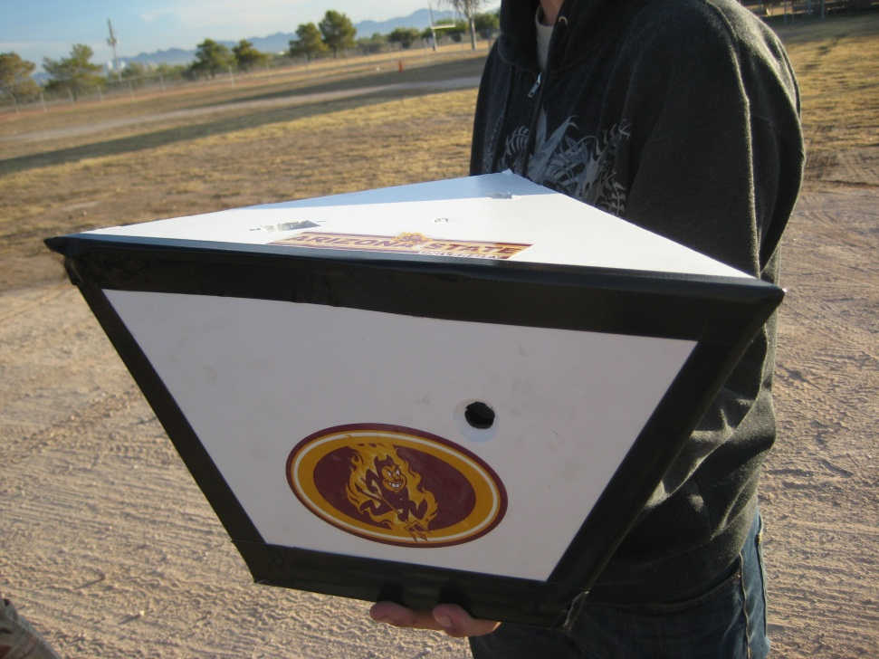
Fall 2009 Structure
Consisted of an inner foam layer as the main structure
Outer layer was made of an insulation foam
Attachment rod passed through the entire structure
In order to withstand the shear stresses caused by the rod, the inner foam was reinforced with an epoxy resin

Slide 4
Structural problems
The video camera fell out of alignment
Critically, the microprocessor detached from the circuit board, shutting off both the camera and the video camera
To correct this, we knew that future structures had to be reinforced more so on the inside
The outside casing suffered little damage

Slide 5
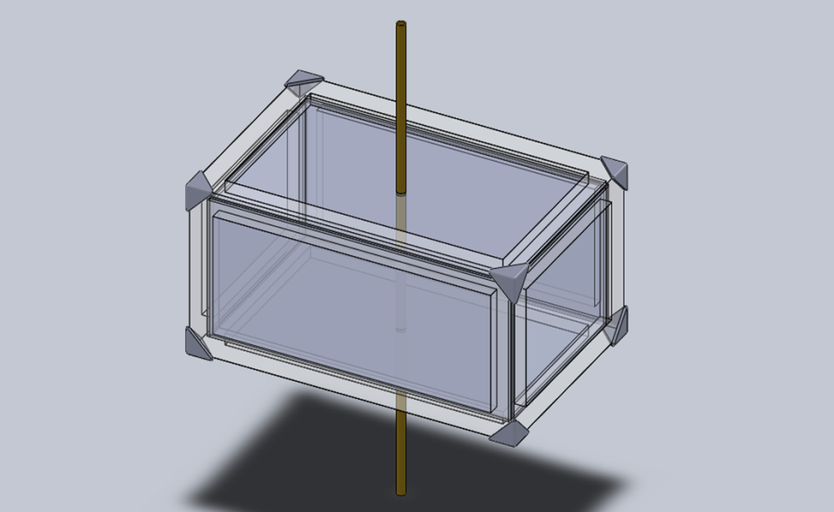
2010 spring structure
Lexan was an excellent material for this structure
To increase amount of volume and space for attachment points a rectangular shape was used
Beveled edges increased surface area for adhesive to spread across, decreased shear stress at edges
Between the adhesive and the pressure from the connecting rod structure was far stronger than previous model

Slide 6
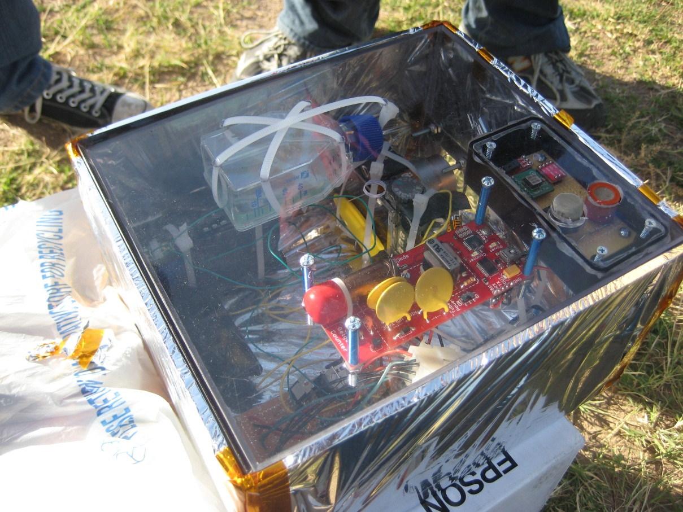
Component Attachment points

Slide 7
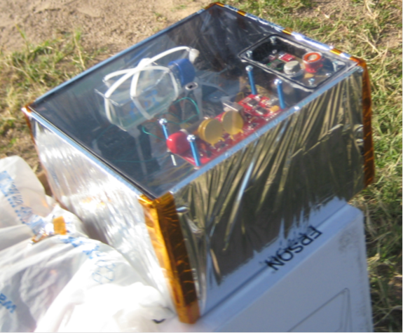
Completed structure
Outside layer was added for insulation, while leaving the top open
Outside layer helped distribute any impact across the surface of the Lexan, further increasing impact tolerance

Slide 8
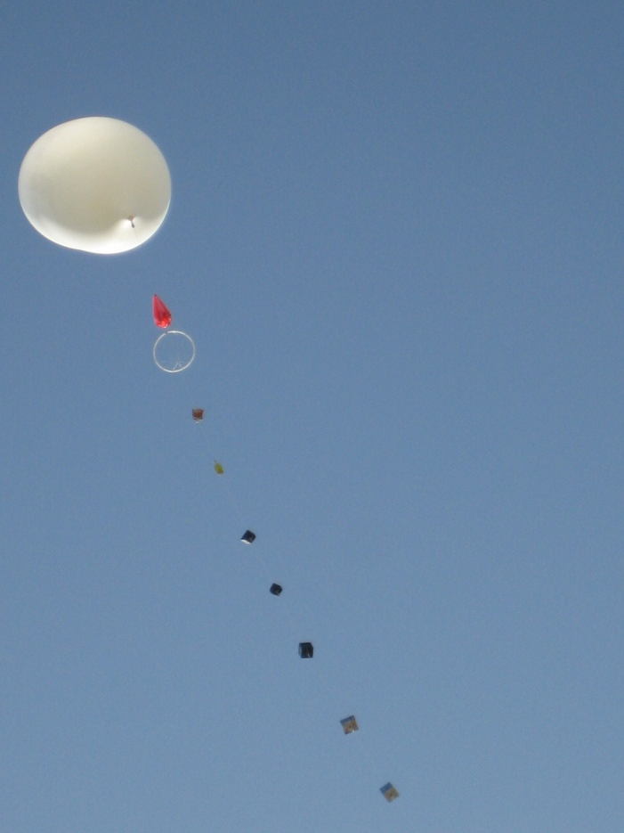
Launch!

Slide 9
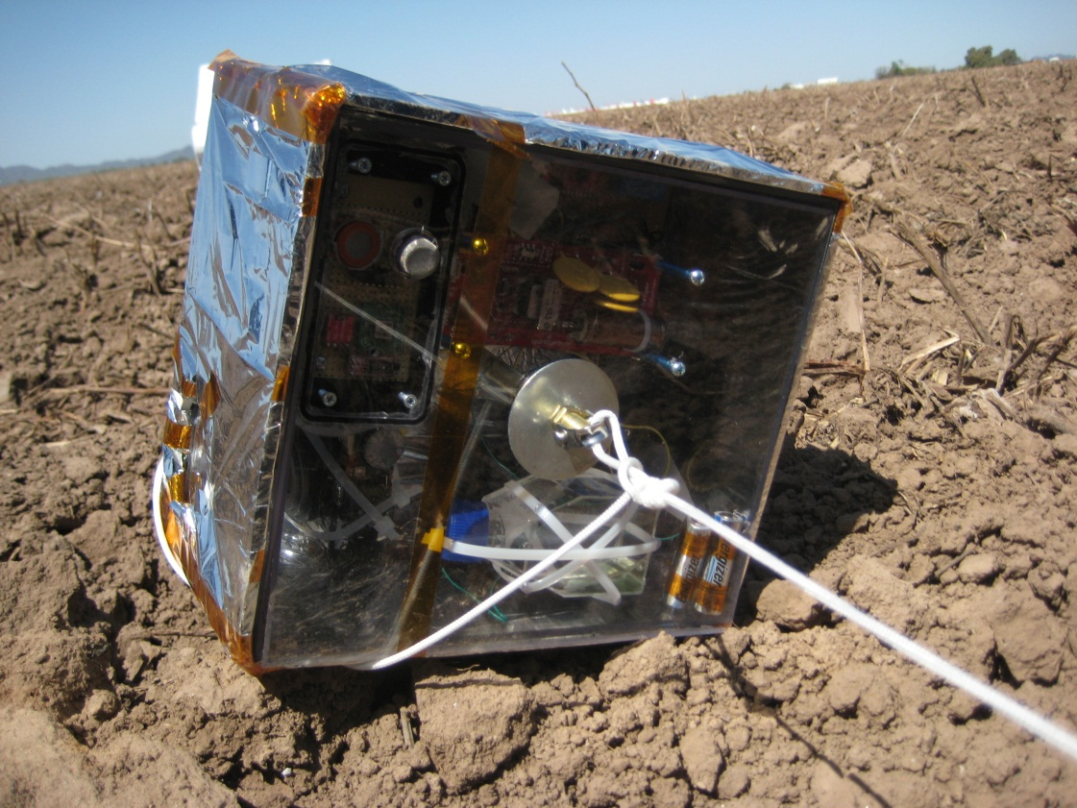
Recovery
No damage to exterior
Despite better securing methods, things still came loose
Voltage regulator on main circuit board was damaged

